Slide 1


ArcGIS API for JavaScript: Using Arcade with your Apps
Kristian Ekenes & David Bayer
2018 Esri DEVSummit Conference | Palm Springs, CA
Notes:
[David]
We want to give yo

Slide 2


Session Goals
Overview of Arcade
What is Arcade
Why use Arcade
Arcade Language
Variables, Functions, Loops, Conditional Statements
Arcade and the ESRI JavaScript API
Using Arcade in Custom Apps
Notes:
[DAVID]
In this session, we are going to give an Overview of Arcade… What it is, and why you would want to use it.
We are going to look at the language, and then lastly look at how you can use it in your own Apps, written in JavaScript.
Now Lets get into the really important questions. These are the questions we are most commonly asked about Arcade

Slide 3
A new expression language for the ArcGIS Platform
ArcGIS Pro
Runtime SDKs
JavaScript API
Web apps
Primarily designed for ArcGIS web maps and web scenes
What is Arcade?
Notes:
What is Arcade…. We see Arcade is an Expression language that can be used across the ArcGIS platform.
You can use them in Online, Pro, Web Apps, Other Apps, Runtime APIs, SDKs, Javascript API.
When I refer to an expression language. We are writing expressions that can be embedded in the WebMap or the Webscene. We want texpressions that give extra logic for how a map should be rendered. We want it to Portable. That extra logic to make maps that touch more dynamic
Explain …..
-> History of calling Languages After Street Furniture -> Avenue
-> UK Connection… One of the Development Teams was in Wales
-> Arcade a Smaller, Safer Shopping Street
-> Seemed to Work… We did consider other names… Boulevard, Roundabout

Slide 4
Arcade Purpose
Arcade is NOT intended to be a Full Programming / Scripting Language
Goal : Lightweight and Simple
Equivalent to a Spreadsheet Cell Calculation
Embedded Expressions
Labeling, Rendering, Symbol Variation, ….
Sharing
Not a replacement for Python for geoprocessing and Automation
Input Values
Arcade
Expression
Result Value
Notes:
[DAVID]
It is important to say what Arcade is NOT. It is not meant to be a full programming language or scripting langage. Its goal is to be lightweight, equivalent equivalent to an Excel Spreadsheet cell calculation.
That’s a good way of thinking about it… It takes input values, applies logic, and gives you an output value.
It is simply intended to take input values, evaluate them, and return a result value.
We see this being useful in the embedded scenarios.. Such as deciding how features should be rendered, or what a label expression., varying the symbols

Slide 5

Hello World
Notes:
[DAVID]
Playground – Hello World
Website – Developers.arcgis.com/arcade.. Gives a run through of the language, Guide, Function Reference, and usefully a Playground.
Customary to do Hello World.
This is a very simple expression, 1 line and getting a value.
A numerical expression, is evaluated and run.
When we looked at where expressions can be used, we realised that we might need much more complex expressions. So we made the language more complicated.
I can declare a variable, and use a variable.
The language supports wrting functions
Function greet(person) {
}
Greet(“everyone”)

Slide 6
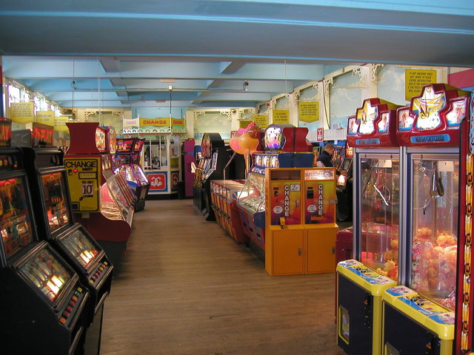

Why is it called Arcade?
Notes:
[DAVID]
Next Question… Why is it called Arcade.
Have to be honest, not named after Arcade Games… Its named after the Archways, or Covered Passageways.
Part of the reason we came up with thename Arcade, is because we had to…We kept on referring to it as that Expression Language, or the ArcGIS Expression language, we needed to give it a name
When we discussed it in the team, we discussed that quite a lot of projects and other languages developed by ESRI had been named after Roads or Streets. We had Avenue, and a number of internal projects similarly named. So we started looking for a road name or something to do with roads. A big part of the development team for Arcade was in the UK, in the Cardiff office. So we were looking for a something with a slightly anglicized feel to it. so Arcade fitted this. We quickly rejected roundabaout and other such names.
Arcade seemed to fit . When we think about Arcades, we think of very self contained, sheltered shopping streets, which kind of fitted what we were trying to do with the language.
The other reason we called it Arcade, is because it had Arc in the title, so we really couldn’t go wrong with that. That is how we got to the name Arcade.

Slide 7
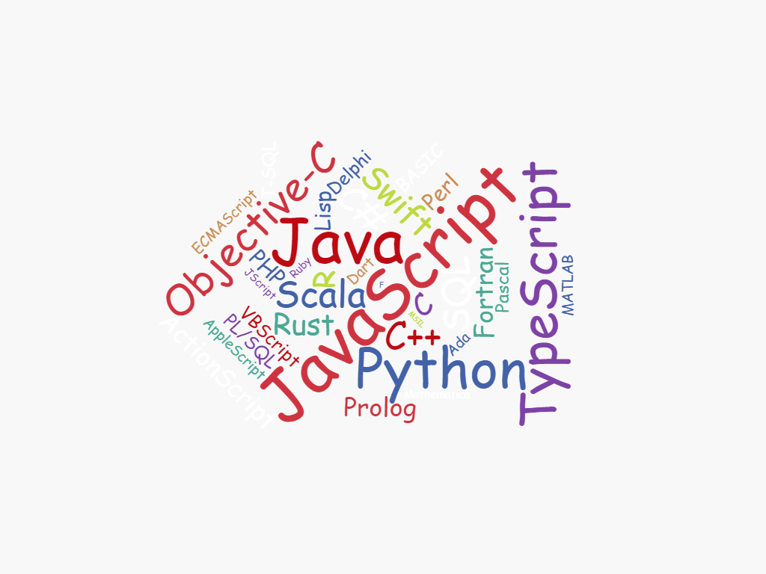
Why do I need another language?
Notes:
[DAVID]
This is a question… We are asked a lot…….. Why have we created another language.
Why another language, there are so many to choose from.. When we went to create the word cloud on this slide, we went onto Wikipedia to get a list of languages and there are literally hundreds of languages.
We really did think long and hard before embarking on writing Arcade… but there were very specific problems we were trying to solve.
To best explain this, we need to look at the ArcGIS platform

Slide 8
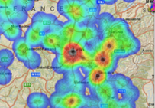
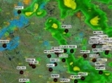
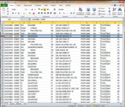
ArcGIS: Make, Share, Anywhere
Notes:
[DAVID]
The big part of the platform is about Sharing. We want to author maps and analysis and publish to the web, and share with as many people as possible.

Slide 9


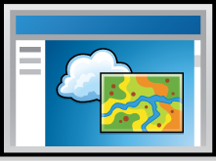
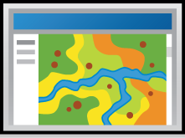
ArcGIS Environments and Platforms
Smart Phones
Social Media
Tablets
Web Sites
Desktop
Browsers
Notes:
[DAVID]
When you look at the ArcGIS Platform, and share maps, you see that the ArcgIS platform is on so many different devices…..
It is on phones, tablets, web pages, desktop, smart phones, embedded in social media site.
That creates real challenges for writing logic in maps, and have that shareable across many different devices.

Slide 10



ArcGIS: Make, Share, Anywhere - Challenges
Traditional Development / Scripting Languages
Browser based Apps
Mobile and Native Apps
Size of Executable
Security
Native Access
Page Size
Security
XSS
No Binaries
Notes:
[DAVID]
When we look at putting scripting logic in a Runtime App, or a Web Page, we come across very specific issues.
The size of the scripting engine. Phone apps are kept very small. Putting a full Scripting Engine like Python or Javascript adds a significant size to the download.
Security is an issue on these devices/apps. You cannot just run script, as a fully scripting language can do many unauthorised actions. Similarly with Web Pages, you cannot download and execute any arbitrary Javascript… That introduces security vulnerabilities, and cross site scripting attacks.
This lead us to a set of Goals for the Arcade Language

Slide 11
Arcade Goals
Portable
Write an Expression in Pro, have it run in a Browser, or on a Device
Secure
Ensure that Expressions or Scripting do not compromise Security
Lightweight
Most requirements for Scripts and Expressions are Lightweight. The language should be small, and fast
Geospatial
Scripts should treat Geospatial as First Class Members
Notes:
[DAVID]
The goals of Arcade are as follows.
That’s what lead us to developing and having a language called Arcad

Slide 12
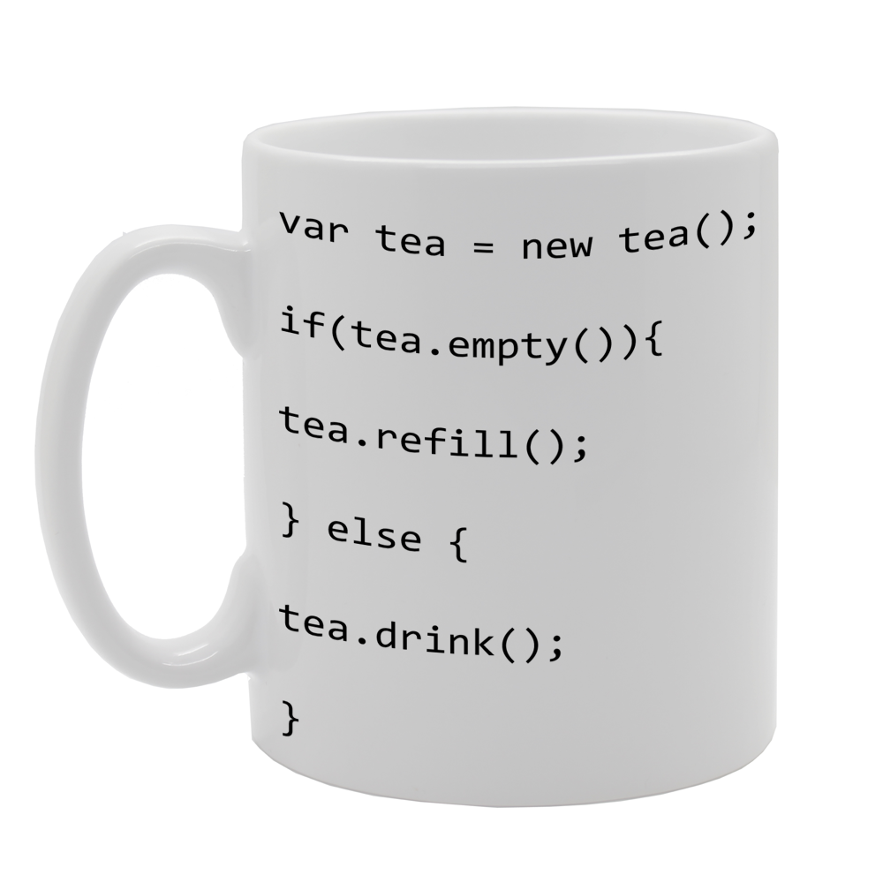
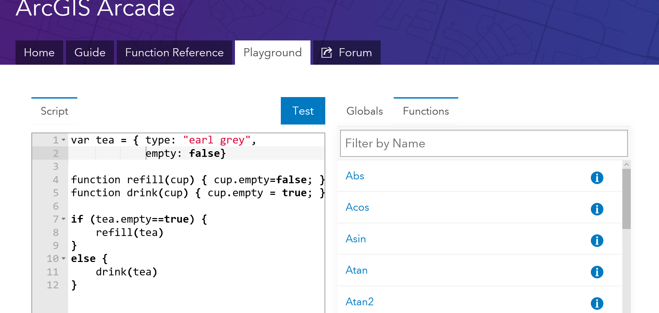
What can I do with it?
Notes:
[DAVID]
The final question is….
That’s difficult to answer, there is what you can do with it now, and what you will be able to do it in the future.
Can it be used for the classic tea making problem.
Best to show examples of where it can be used.

Slide 13
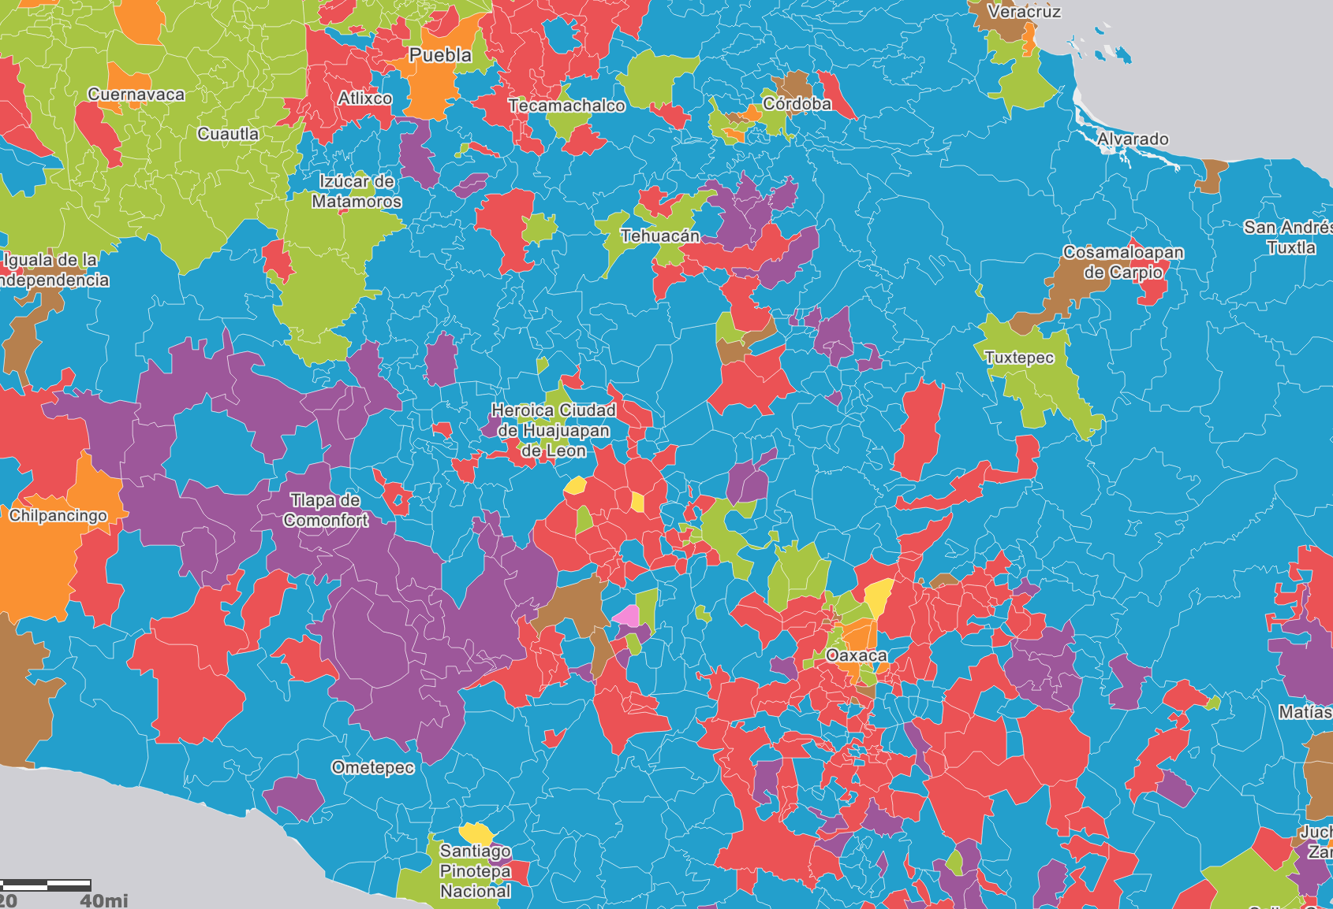
Arcade
Examples
Notes:
[DAVID]
Pro : Labelling Demo, Parce Script and Wind Demo

Slide 14
Language Overview
Type System
Flow Control
Statements
Functions
Statements
and Operators
Notes:
[DAVID]
OK… Hopefully you can see why we have written Arcade.
We are now going to go into the Language a Bit. So you can see how we have tried to reach the goals of simplicity and ease of use, but also so you can see how to achieve common tasks.

Slide 15
Arcade : Language Features
Designed for Simple Expressions
Single Line - Implicit Returns
Case Insensitive Language
Dictionary Syntax for Field Access
Has Language Features to Support more Complex Scripts
Type System
Implicit and Explicit Type Casting
Flow Control Statements: IF, FOR
Variable Declaration and Assignments
User Defined Functions
Arcade Scripts run and return a value. They are self contained and cannot alter their environment.
Notes:
[DAVID]
Firstly , we tried to design the language for Simple Expressions, and Familiarity..
We wanted it to work for the simplest of single line expressions…. Say just to put a calculation in based on a Field.
We also recognised that many of the labelling, renderering scripts that exists in Pro today, written in Python can be quite complex…
So we wanted to support more complex language features.
Do need to emphasize though, that Arcade is not intended to change its environment, it is simply a calculator, and is self contained.

Slide 16
Implicit Returns
(10 + 100) * 30
Equivalent to:
return (10 + 100) * 30;
Implicit Returns
Last executable statement that is a value, will automatically be considered the return value.
Enables very simple Single Line Expressions
Notes:
[DAVID]
So firstly for simple expressions, we have the concept of Implcit Returns.
The last executable statement that is a value, will automatically be considered the return value… Allows you, for single line expressions, not to have to use the return statement.
A small feature, but allows very succinct single line expresions.

Slide 17
Case Insensitive
UpPeR(“Hello”)
$FeAtUrE.FiElD1
Language is Case Insensitive
Quicker to Author
Simpler for working with Data, and Field Names
Notes:
[DAVID]
Case Insentitivity… We had a lot of discussions on this.
We have made the language case insensitive so it is less fussy to author. However the main reason, was to make it easier to work with fields.

Slide 18
Functions
Data Functions
Dictionary
DomainCode
DomainName
Feature
First
HasKey
IndexOf
Reverse
Sort
TypeOf
Date Functions
Date
DateAdd
DateDiff
Millisecond
Minute
Hour
Month
Weekday
Year
Day
Now
Today
Logical Functions
IsEmpty
DefaultValue
When
Decode
Iif
Boolean
Mathematical Functions
Abs
Acos
Asin
Atan
Atan2
Average
Ceil
Cos
Count
Exp
Floor
Log
Min
Max
Number
Pow
Random
Round
Text Functions
Concatenate
Console
Find
Lower
Left
Mid
Proper
Replace
Right
Split
Text
Trim
Upper
Sin
Sqrt
Stdev
Sum
Tan
Variance
“
Functions are the Power of Arcade
Notes:
[DAVID]
The key to the language though is the range of functions, and we want to add a lot more!

Slide 19
Functions : Geometry
Geometry Functions
Geometry
Multipoint
Extent
Polyline
Polygon
Area
AreaGeodetic
Buffer
BufferGeodetic
Centroid
Clip
Contains
Crosses
Cut
Difference
Disjoint
Distance
Equals
Intersection
Intersects
Length
LengthGeodetic
MultiPartToSinglePart
Overlaps
Relate
SymmetricDifference
Touches
Union
Within
“
Functions are the Power of Arcade
Notes:
[DAVID]
The key to the language though is the range of functions, and we want to add a lot more!

Slide 20

Global Variables and Profiles
Labeling
Rendering
Use expressions to provide values required for different types of Renderers
Global Variables
$feature
$view
Use expressions to provide values required for different types of label classes
Global Variables
$feature
$view
Popup
Use expressions to provide values for popup tables and other content elements
Global variables
$feature
“
Profiles provide the purpose for executing an Arcade Expression
Notes:
[DAVID]
A big part of Arcade is how it is used, or how it is called. What we refer to as profiles. Profiles provide the reason for executing Arcade.
We have spoken about the Rendering profile, there is also the Labelling Profile and the Popup Profile.
These profiles determines what Global variables are passed in. As we come up with more uses of Arcade, we will have different profiles, which will each define what variables are passed in.
However we are trying to have consistency between the profiles.

Slide 21

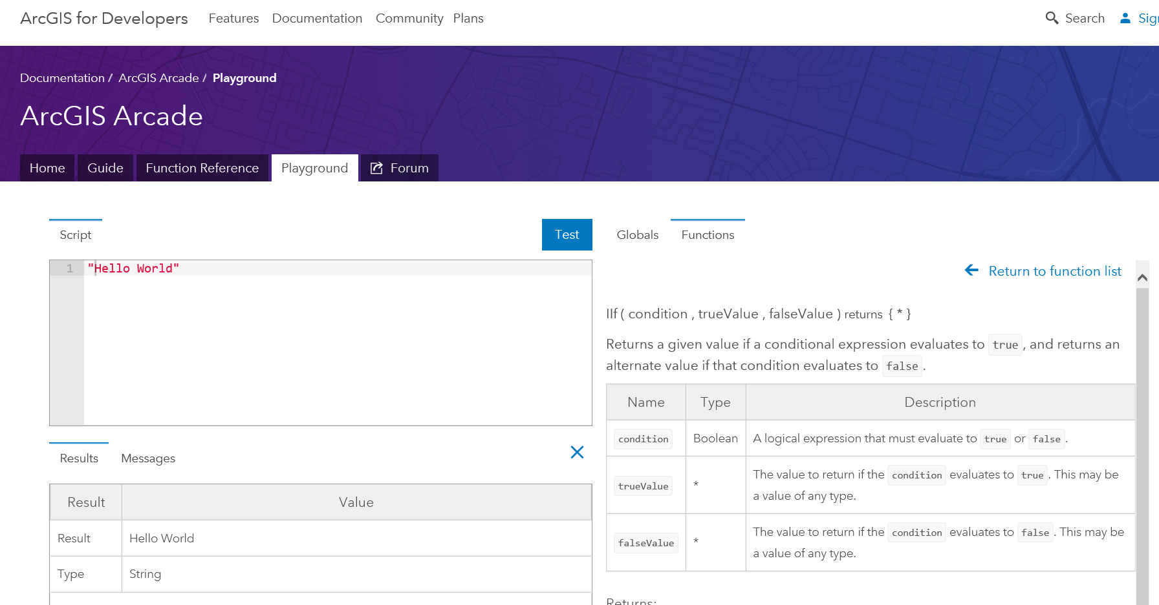
Exploring Profiles and Functions in the Playground
Notes:
[DAVID]
Demo of the Playground and Profiles
In playground, look at the Labelling Profile, or the Rendering Profile
You can explore and change parameters in the Plaground.

Slide 22
Type System
var myNumber = 10;
var myText = “Hello”;
var myDate = Date(2015,1,1);
var myBool = true;
var myDictionary = { “key1”: 10 };
var myFeature = { “geometry”: {…}, “attributes” {“key1”: 10 }};
var myArray = [1,2,3];
var myPoint = Point({….});
Simple Types
Numbers
Booleans
Dates
Strings
Object Types
Dictionary
Feature
Array
Point
Line
Polygon
Multipoint
Dates, Dictionary, Feature, Point, Line… all have overloaded constructors.
Notes:
[DAVID]
Continuing with the Language.. Arcade does have a Type System
We have added GIS Specific types, like Feature, Point, Line, Polygon, MultiPoint.

Slide 23
Implicit and Explicit Type Casting
Implicit Casting
For Function Parameters
For Expressions
Explicit Casting
Functions cast between types
Number, Text, Date, Boolean
Implicit Casting
return 10 + “Hello”
Explicit Casting:
return text(10) + “Hello”
Notes:
[DAVID]
As there is a typesystem, there is Casting between types.
We had a lot of discussions on casting, and what was correct behaviour

Slide 24
If Statement
if (myvalue==true) {
return 1;
}
else {
return 2;
}
Equivalent to:
IIF(myvalue==true, 1, 2)
Traditional IF Statements are supported
For simple single line expressions, consider using Functions
IIF
Decode
When
Notes:
[DAVID]
As you would expect we have flow control statement and logic statement.
So we have IF… But you may also want to consider using IIF, Decode, and When, which allow you to use functional equivalence.

Slide 25
For Statement
for (var z=1; z<100; z++ ) {
k+=z;
}
for(var k in myArray) {
n+=myArray[k];
}
For Statements
Same syntax as JavaScript
For In Statements
Iterates over indices of an array, or field names of a Dictionary or Feature
Break, Continue and Return Statements Supported inside Block
Notes:
[DAVID]
For Statements….
You have break, return and continue all supported

Slide 26
User Defined Functions
function MultiplyNumber(thenumber) {
return thenumber*10;
}
MultiplyNumber(10);
Function Keyword used to Declare Functions
Must be Declared ahead of Use
Variables defined inside of Function, have Local Scope
Functions cannot be declared inside of Functions.
Notes:
[DAVID]

Slide 27
Variable Assignment
++myNumber
i=i+1;
myArray[10]=11;
myFeature.Field1 = “ddd”;
Variables can have their values reassigned.
Objects Types maybe Immutable, if passed into Arcade.
Arrays are not Sparse. They must be sequential.
Geometry Types are immutable inside. You cannot change the points in a path of a line.
Notes:
[DAVID]
We also have variables, that can assigned and reassined.

Slide 28
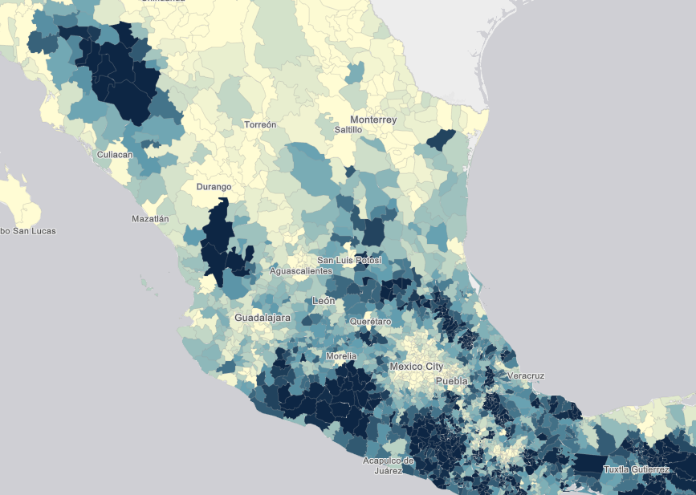
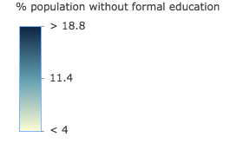
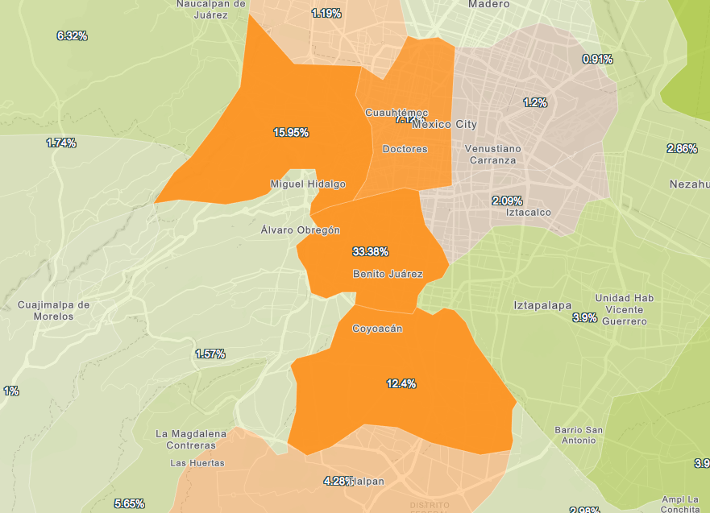
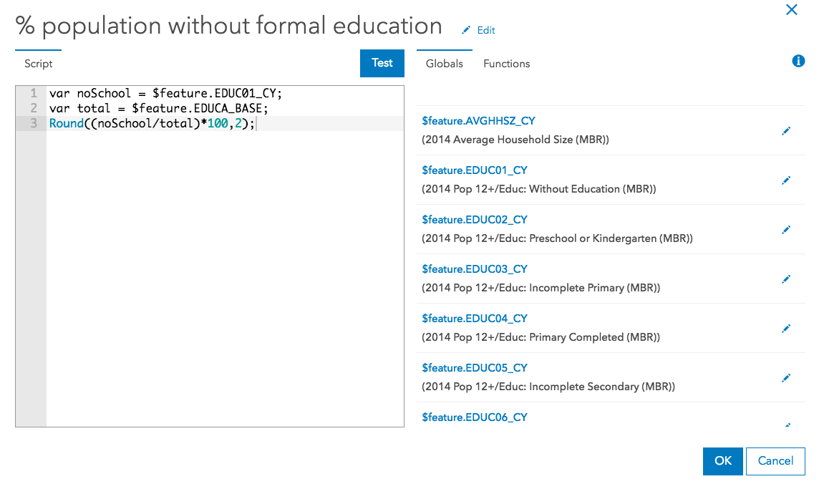
Demos
Notes:
[KRISTIAN]
Now you have seen the language….
Lets look at more Complex Examples

Slide 29

Arcade and the ESRI JS API
ESRI JS API
Version 3.23
ESRI JS API
Version 4.6
Arcade
Arcade
Inside
Inside
“
Arcade Interpreter available in both 3.23 and 4.6 JavaScript API
Notes:
[KRISTIAN]
Now you have seen the language….
Lets look at more Complex Examples

Slide 30
ESRI JS API and Arcade Profiles
Arcade Expressions set as Properties
Classes that support Arcade Expressions
ClassBreaksRenderer LabelClass
UniqueValueRenderer PopupTemplate
visualVariables
Color
Size
Opacity
Rotation
Supported for FeatureLayer and SceneLayer
Notes:
[KRISTIAN]
In the JS API, Arcade is exposed as properties of existing Classes.
So you can set valueExpression for ClassBreaksRenderer and UniqueValueRenderer
You can set Color, Size, Opacity, Rotation Visual Varuables

Slide 31
ESRI JS API : Arcade Expressions
var renderer = {
type: “class-breaks”,
valueExpression: "( $feature.TOT_VOTES / $feature.REG_VOTERS ) * 100",
valueExpressionTitle: "Title to Display"
classBreakInfos: [ ... ],
};
Expression Properties are set as Literal Strings
Arcade Interpreter will Execute valueExpression for every Feature
Notes:
[KRISTIAN]

Slide 32
ESRI JS API : Arcade Expressions in JS API 3.23
Arcade Expressions can be used For Labeling
var labelClass = new LabelClass({
labelExpressionInfo: {
expression: "$feature.STATION_NAME"
},
labelPlacement: "below-right",
minScale: 2500000
});
nameClass.symbol = new TextSymbol();
// set the label class to the feature layer
featureLayer.setLabelingInfo([ labelClass ]);
Notes:
[KRISTIAN]
In 3.23, It is also supported for Labelling Expressions.. Here is an example

Slide 33
Practicalities: Scripts in Script
<script type="text/plain" id="myScript">
Proper($feature.CityName)
</script>
...
var arcadescript = document.getElementById(“myScript").text;
Scripts within Scripts
Lots of String Escaping.
Embed Script in HTML using MIME type text/plain
Notes:
[KRISTIAN]

Slide 34
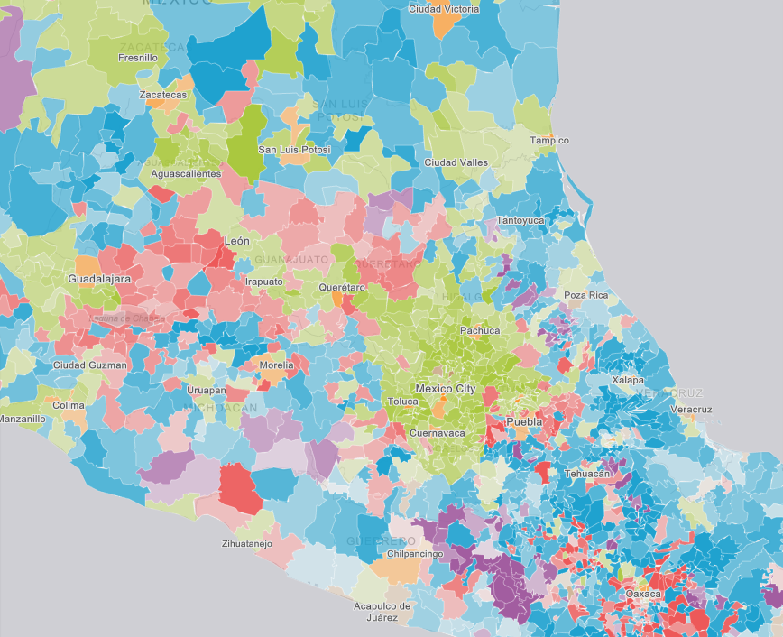
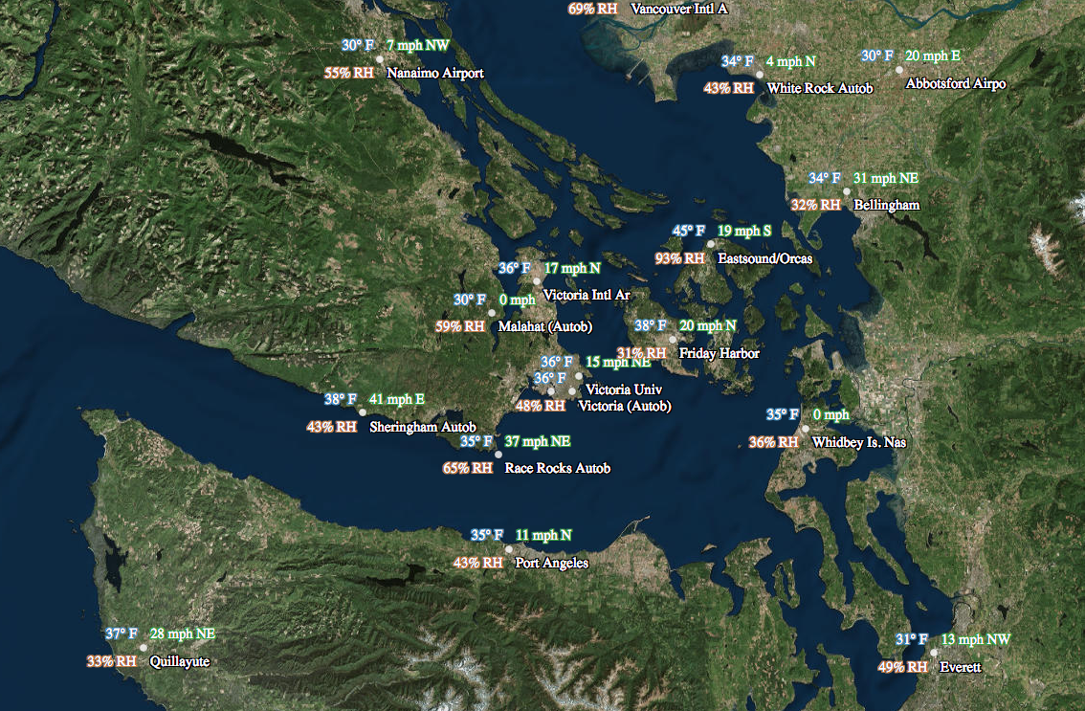
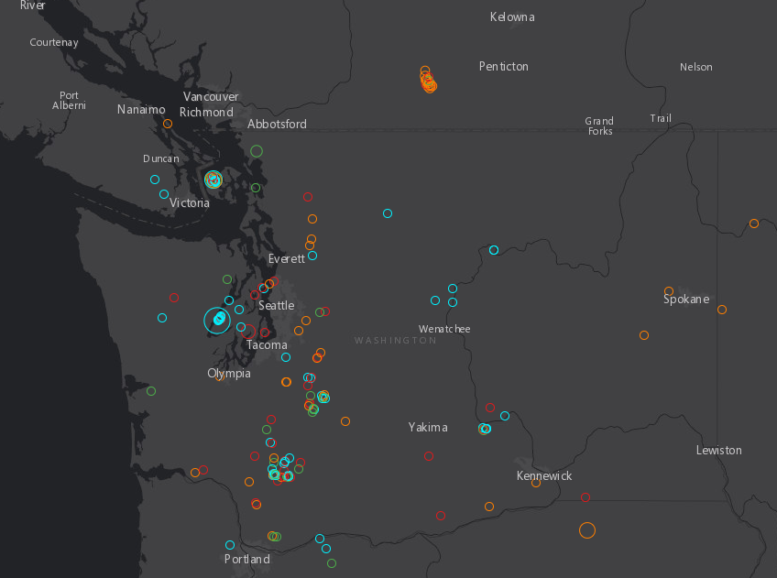
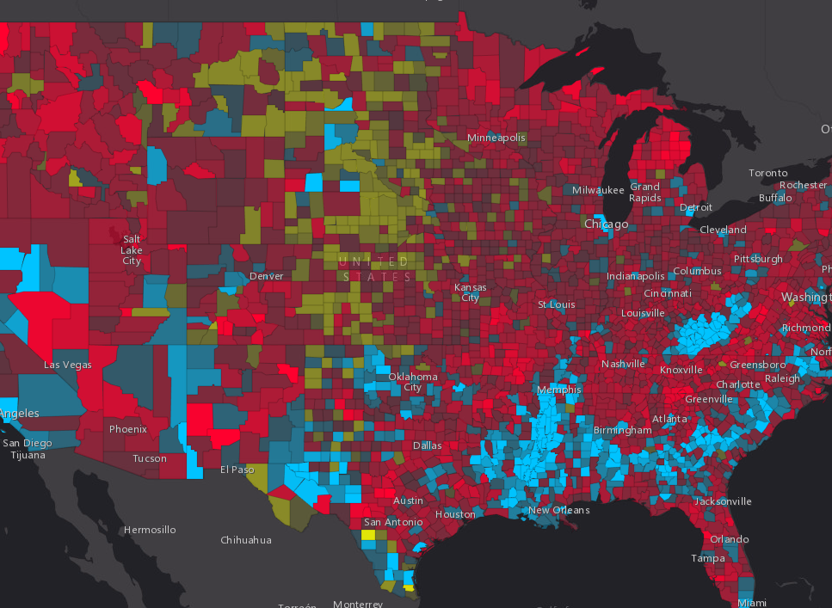
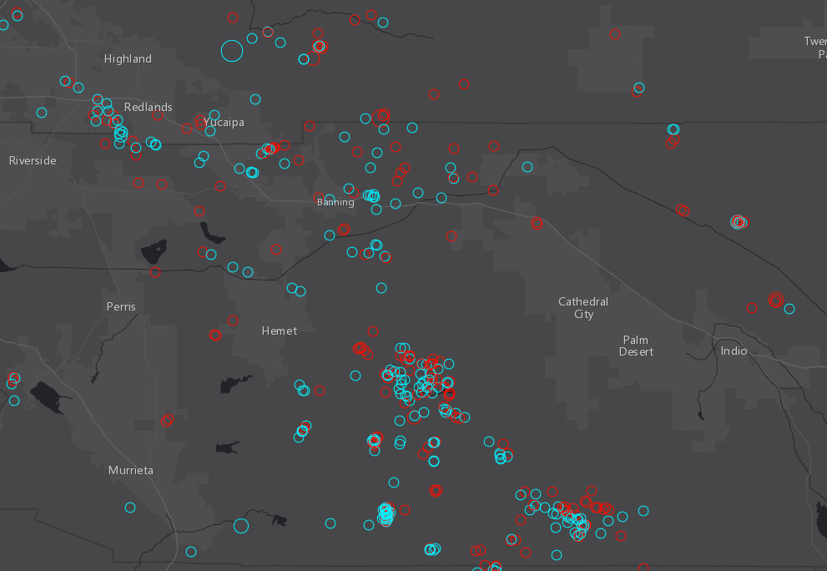
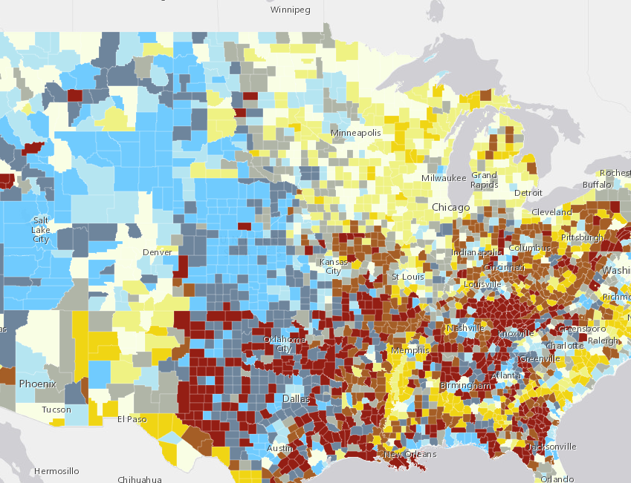
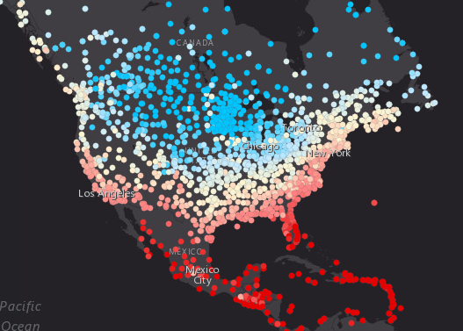
Demos
Notes:
[KRISTIAN]

Slide 35
Expression sharing

Slide 36
Future
Notes:
[David]

Slide 37
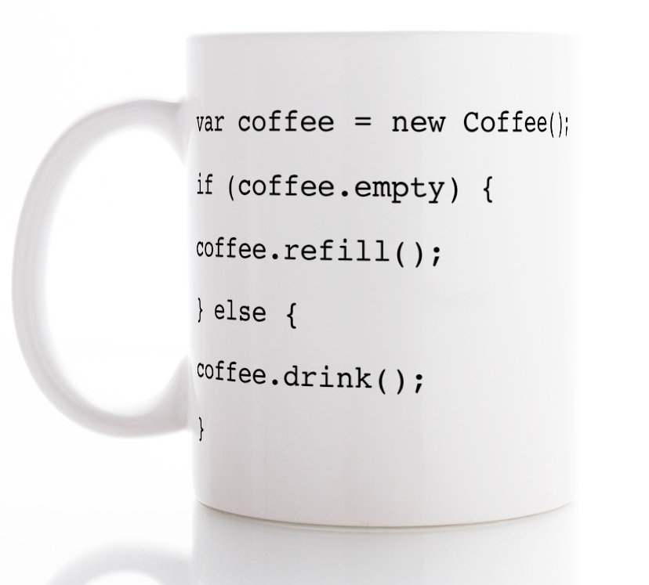
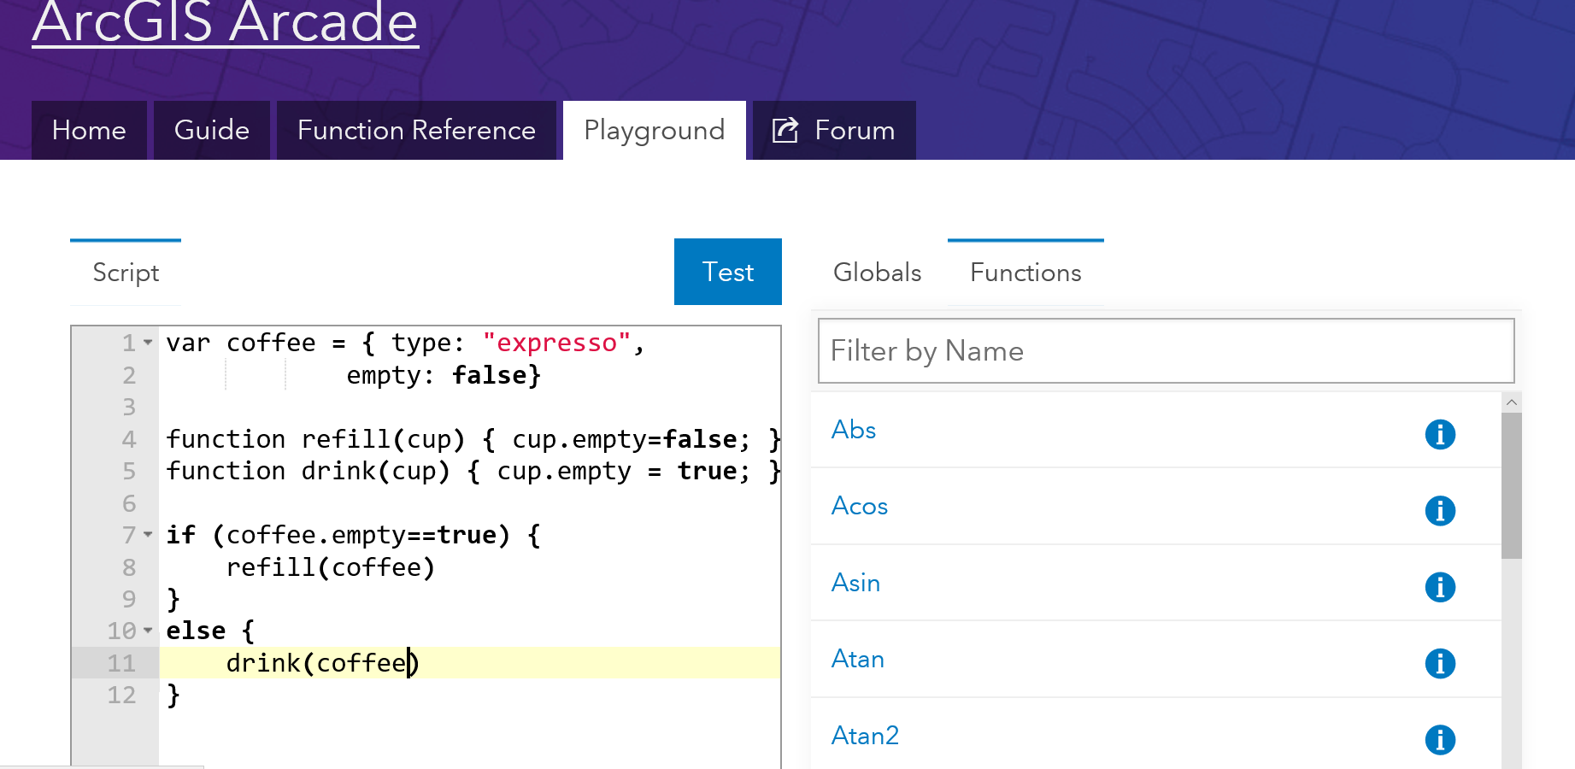
More uses of Arcade
Field Calculators
Notes:
[DAVID]
Firstly we want to use Arcade in more places within the ArcGIS Platform

Slide 38
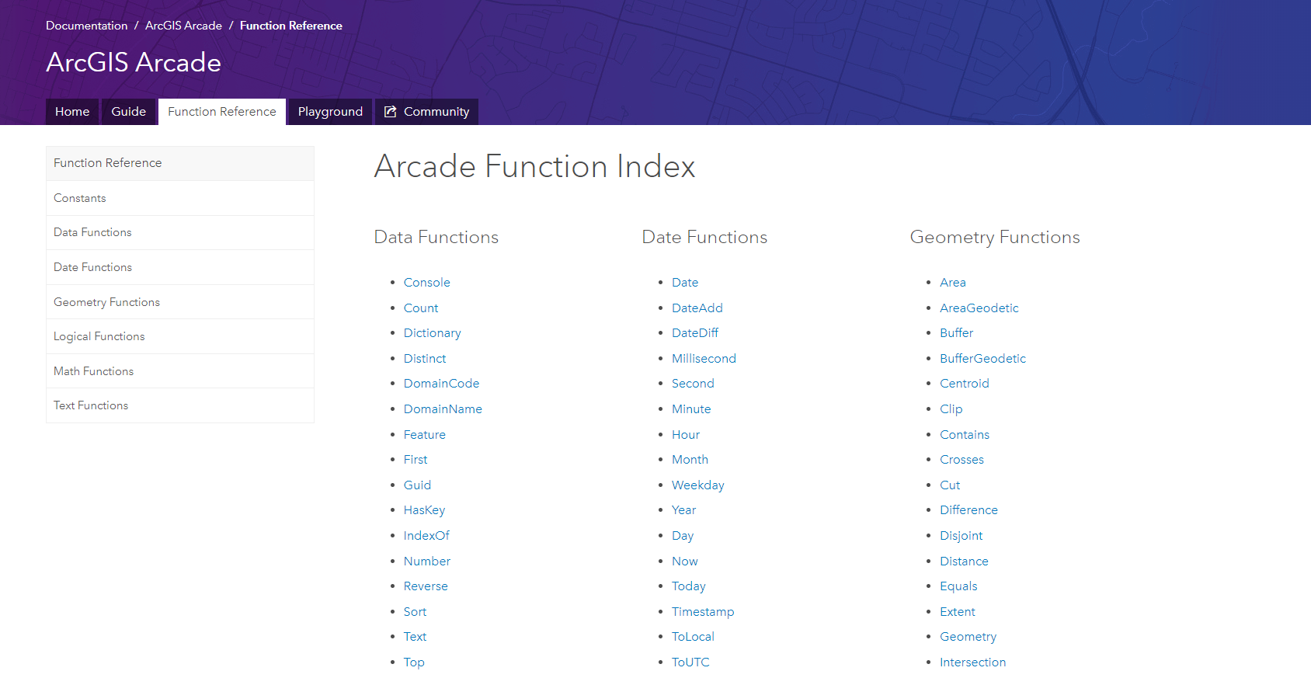
Adding Functions &
Profiles
Identifying common operations and use cases
Let us know what you need!
Notes:
[DAVID]
We want to added more functions, to make Arcade more powerful

Slide 39

Finding Arcade Resources
Notes:
A big headache with any language or script expression.. Whether it is an Excel Formula, ActionScript, JavaScript or C# is where to find resources.
We have spent a bit of time putting together the help for Arcade online

Slide 40
Resources
For Arcade Documentation
https://developers.arcgis.com/arcade
Playground https://developers.arcgis.com/arcade/playground/
Using Arcade with JS API
https://developers.arcgis.com/javascript/latest/guide/arcade/index.html
Blogs and Posts https://blogs.esri.com/esri/arcgis/2016/12/19/introducing-arcade/
https://blogs.esri.com/esri/arcgis/2016/12/15/use-arcade-expressions-to-map-your-ideas/
http://odoe.net/blog/hello-arcade/
https://blogs.esri.com/esri/arcgis/2017/01/10/using-arcade-expressions-in-web-apps/
https://blogs.esri.com/esri/arcgis/2017/10/18/unwinding-the-clock-visualizing-time-with-arcade/
https://blogs.esri.com/esri/arcgis/2017/05/23/creating-a-predominance-visualization-with-arcade/

Slide 41
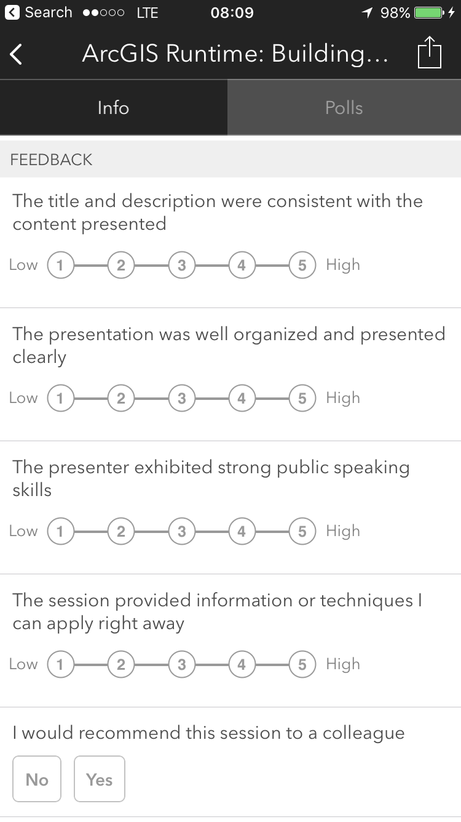
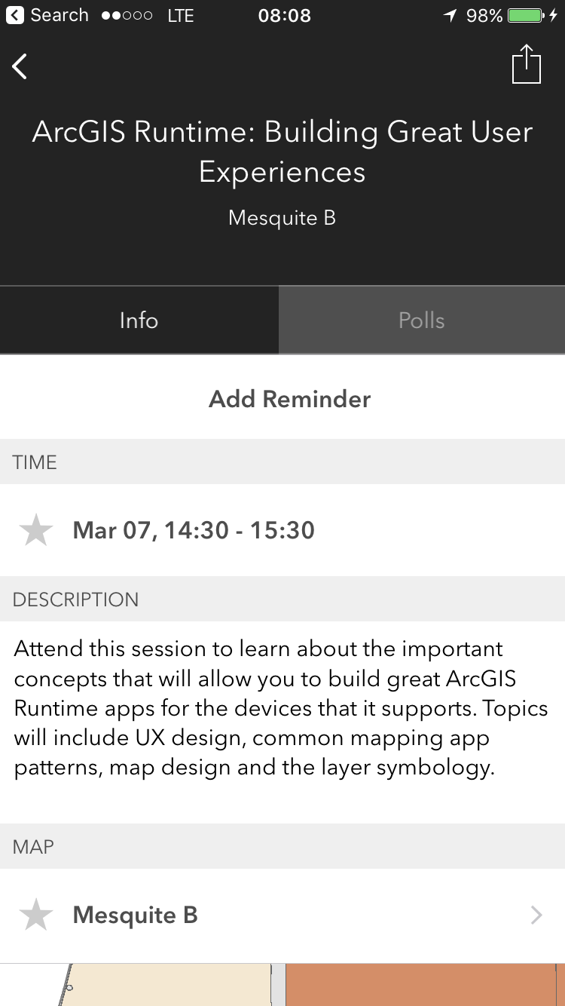
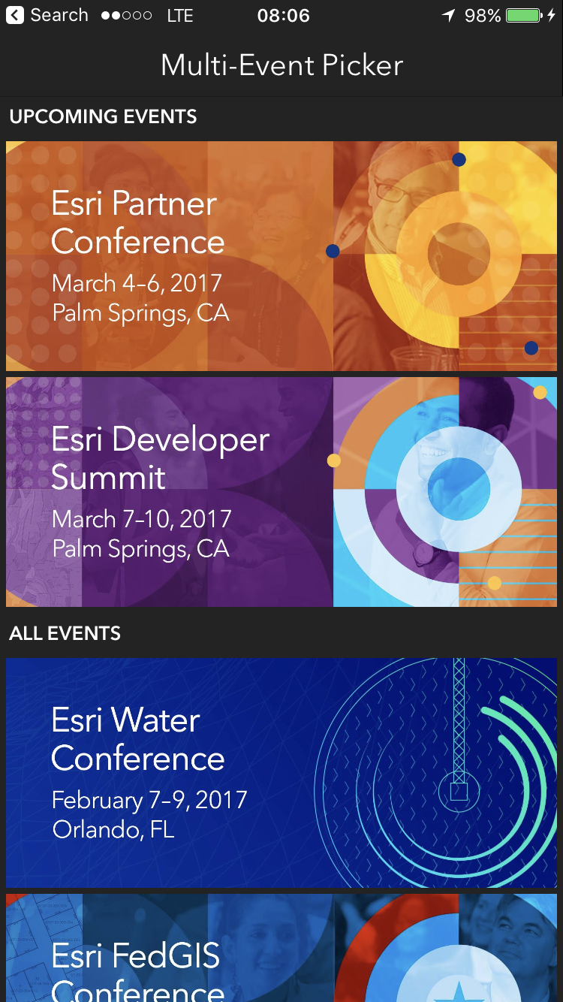
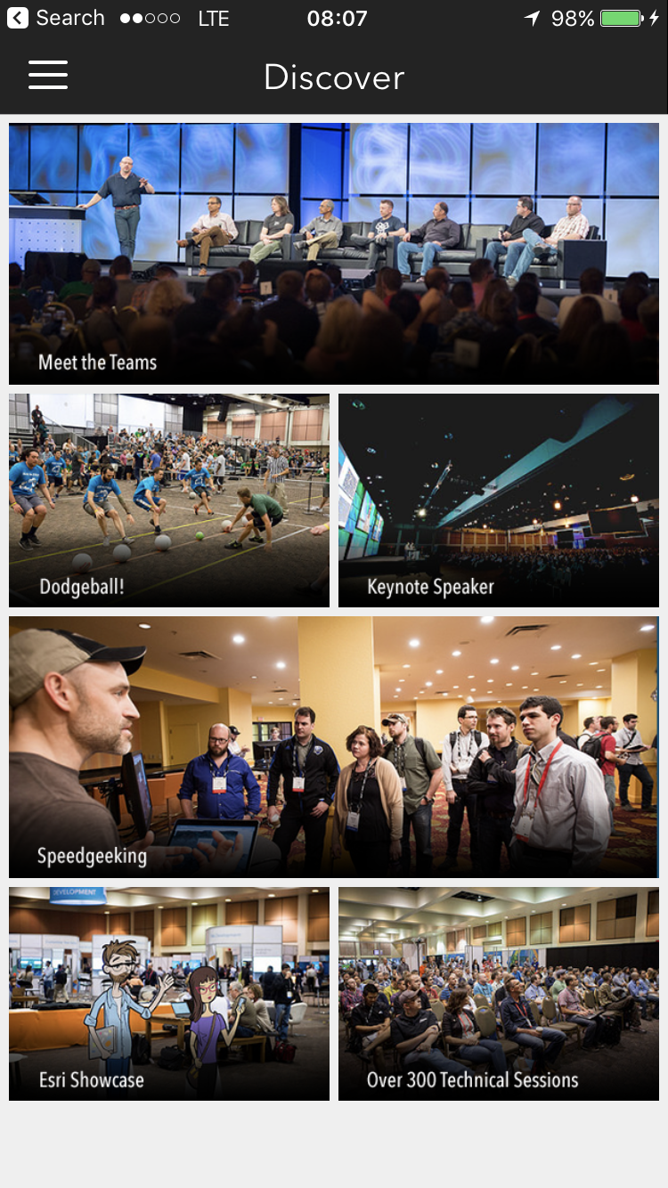
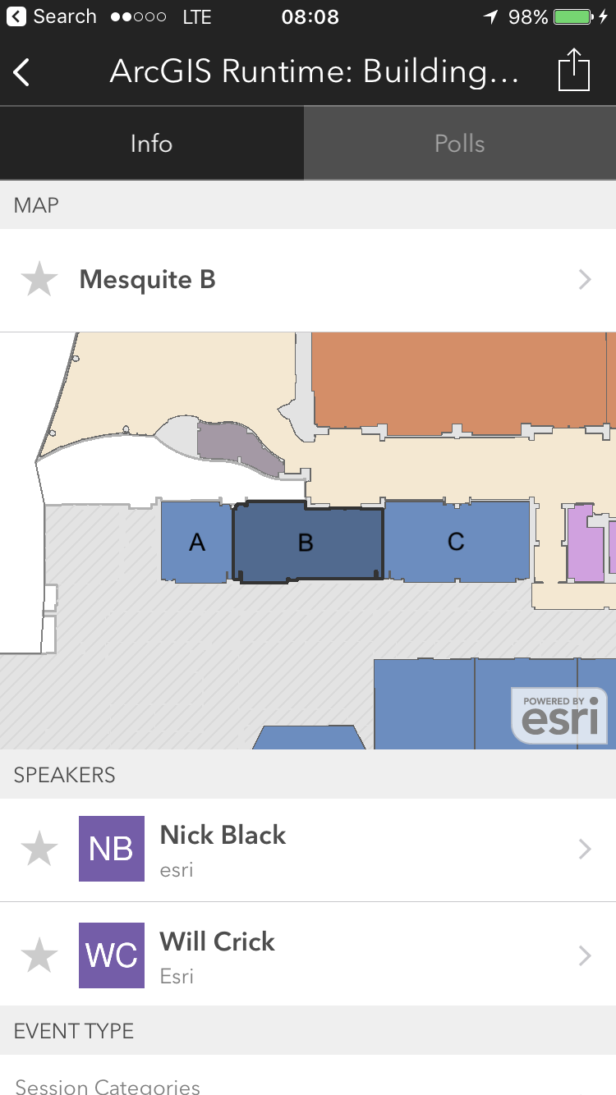
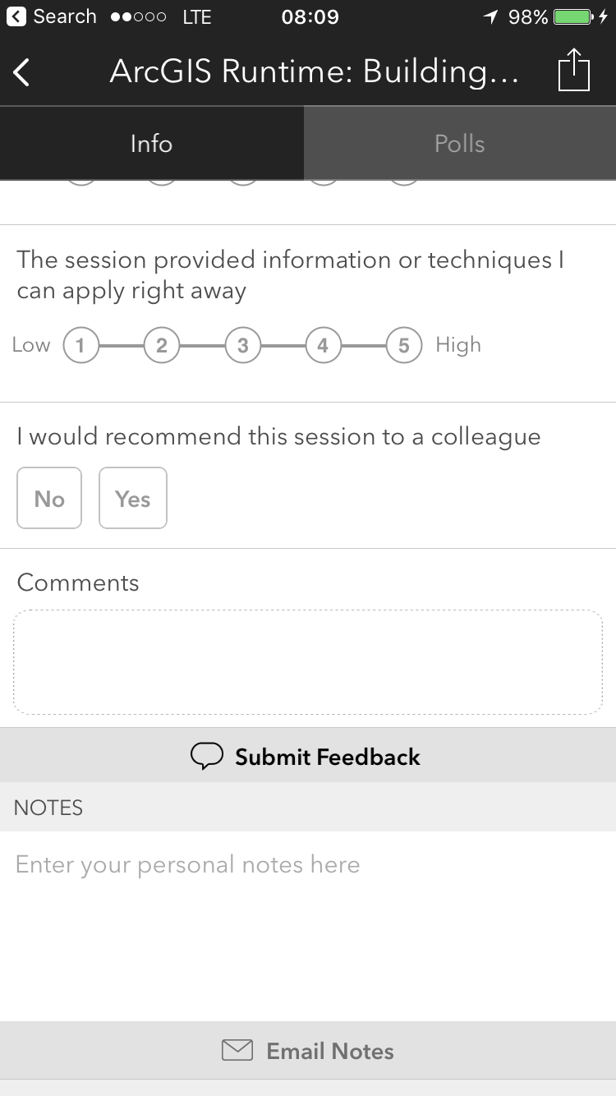
Please Take Our Survey!
Scroll down to the
“Feedback” section
Download the Esri Events app
and go to DevSummit
Select the session you attended
Complete Answers,
add a Comment,
and Select “Submit”

Slide 42



